Slide 1
Inflation Rate Classification Based on Economic Indicators
Proposal

Slide 2
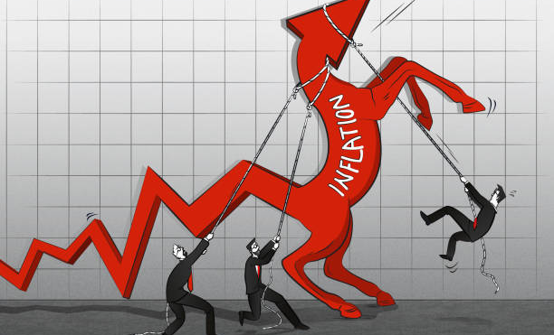
Background & Motivation
Inflation monitoring steers monetary policy and investment strategy.
We propose a data-driven “inflation thermometer” using publicly released macro-indicators (CPI, PPI, unemployment, industrial production, yield-curve spreads, inflation expectations).
Monthly panel (1970-2024) from FRED will feed machine-learning models to detect Low / Moderate / High inflation regimes more objectively than heuristic rules.

Slide 3
Research Questions
Can economic indicators classify monthly inflation into three regimes (Low < 2 %, Moderate 2–5 %, High ≥ 5 %)?
Which feature combinations (levels, lags, YoY changes, volatilities) maximise out-of-sample accuracy?
How robust are linear SVM and a Neural Network to seasonal adjustment choices and structural breaks (e.g. pre- vs post-Volcker)?

Slide 4

Project Objectives
Build a cleaned, merged FRED dataset of CPI, PPI, UNRATE and related series.
Engineer lag, growth-rate, volatility and recession-dummy features; label each month with Inflation Category.
Train and tune SVM and shallow NN; compare performance via rolling 60-month back-tests.
Test sensitivity to seasonal adjustment and structural splits; document reproducible code and findings.

Slide 5
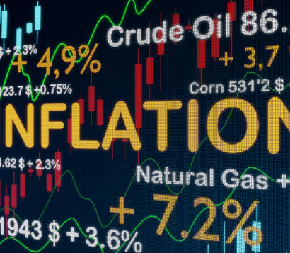
Dataset & Feature Engineering
Source: Federal Reserve Economic Data (FRED).
Series: Headline & Core CPI, PPI, UNRATE, INDPRO, 10 y–3 m yield spread, U-Michigan inflation expectations.
Target labelling function
Features: levels, 12-month % change, 3-month σ, 1–6 month lags.

Slide 6
Planned Models & Methodology
Linear SVM: fast in high-dimensional space; interpretable margins.
Hidden-Layer NN: captures non-linear indicator interactions & regime shifts.
Stratified CV grid search for hyperparameters; class weights to offset imbalance.
Metrics: accuracy, macro-F1, confusion matrix across rolling windows.

Slide 7
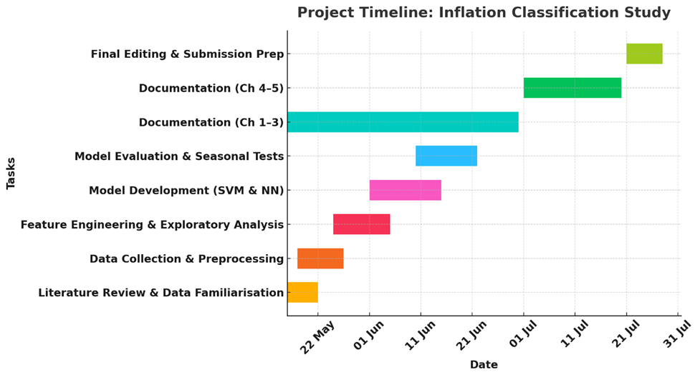
Gantt Chart

Slide 8
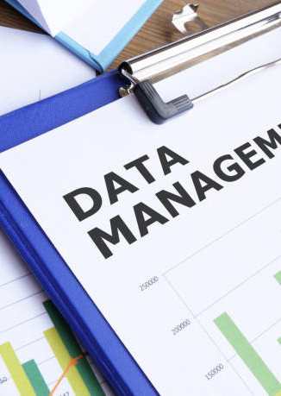
Data-Management Plan
Collection: pandas-datareader scripts pull raw series into /data/raw; every step logged for replication.
Metadata: raw CSVs < 1 MB; merged feature matrix ≈ 2 MB; model artefacts ≈ 50 MB.
Version control: GitHub repo inflation-classification with weekly commits & semantic tags; large files mirrored to UH OneDrive daily.
ReadMe: project aims, environment setup, reproduction guide, licence, contact info.

Slide 9

Ethical & Legal Compliance
GDPR / UK DPA: Aggregated statistics contain no personal data; legislation not triggered.
UH Ethics: Public, non-personal secondary data → exempt from full review; transparency ensured by open code & replication appendix.
Licensing: FRED permits non-commercial academic use with attribution; U.S. government data are public domain.
Provenance: Indicators compiled by official agencies under vetted methodologies, eliminating collection-ethics concerns.

Slide 10
Identify most predictive macro signals for regime detection.
Benchmark SVM vs NN accuracy and robustness.
Deliver open-source Python pipeline, cleaned dataset, and policy-relevant insights for central-bank dashboards or market-risk monitors.
Expected Outcomes & Contributions

Slide 11
References
Baybuza, I., 2018. Inflation Forecasting Using Machine Learning Methods. Russian Journal of Money and Finance 42–59. https://doi.org/10.31477/RJMF.201804.42
Jin, B., Simionescu, M., 2025. Machine Learning vs. Econometric Models to Forecast Inflation Rate in Romania? The Role of Sentiment Analysis. Mathematics 2025, Vol. 13, Page 168 13, 168. https://doi.org/10.3390/MATH13010168
Khashimova, N., Buranova, M., 2023. Comparative Analysis of Machine Learning Algorithms for Inflation Rate Classification and Economic Trend Forecasting. ACM International Conference Proceeding Series 274–282. https://doi.org/10.1145/3644713.3644749

Slide 12
THANK YOU!

